Slide 1
Enlisted Assignment Special Programs
Notes:
Time Required: 70 min

Slide 2
Enabling Objective
IDENTIFY the types of Enlisted Special Programs available
DISCUSS eligibility requirements
IDENTIFY forms required for completion
Notes:
FACILITATOR GUIDE:
Review objectives.

Slide 3
References
Navy Military Personnel Manual (MILPERSMAN), NAVPERS 15560D
MyNavy HR Website- https://www.mynavyhr.navy.mil/
MILPERSMAN 1306-900, Assignment of Enlisted Personnel to Special Programs
OPNAVINST 1500.75D, Policy and Governance for Conducting High-Risk Training
Manual of the Medical Department (MANMED) P-117, chapter 15 article 15-95
Notes:
FACILITATOR GUIDE:
Review references.

Slide 4
Assignment to Special Programs
Motivated Sailors looking for challenging and rewarding tour assignments should apply for Special programs.
These tours provide opportunities for sailorization, development of leadership skills, mentorship, and overall fleet impact.
Special programs are divided into two categories:
Sea Special programs (PERS 409)
Shore Special programs (PERS 4010)
Sailors can request assignment to Sea or Shore special programs by:
Contacting rating detailer for release to special program assignment
Discuss Special Program opportunities at the career decision CDB so they don’t miss an opportunity
Submit NAVPERS 1306/7, 14-16 months prior to their PRD
Notes:
FACILITATOR GUIDE:
1. Sailors must contact their detailer to get released to special programs prior to entering their normal window to apply for orders; if not they will risk becoming a detailer asset and may not receive approval to apply for special program assignments.
2. Ensure Sailors are utilizing most updated MILPERSMAN or NAVADMIN.

Slide 5
Special Program Screening Form NAVPERS 1306/92
Is the primary form to screen Sailors for Sea and Shore special programs
It can be found on MyNavy HR:
References>Forms>NAVPERS
Each program provides guidance for completion (i.e. fill in Section A and C only)
When verifying each section ensure to include supporting documentation for accuracy such as:
Evaluations
PRIMS data
Member Data Summary (NSIPS)
DAPA screening
Several Special Programs have their own screening forms. Refer to the MILPERSMAN for program when completing screening requirements.
Notes:
FACILITATOR GUIDE:
Emphasize to read the MPM that applies to the program the Sailor is applying for because each program has different requirements and may not require all sections to be completed.
Section A should be completed by Admin Officer or Personnel Officer. Ensure to have supporting documentation for each section for verification. If OBLISERV is not complete; ensure to make a note on the form to annotate if it will be completed upon receipt of orders.
DAPA can provide a generate Page 13, annotating the service has been screened and meet the requirements for assignment to special programs.

Slide 6
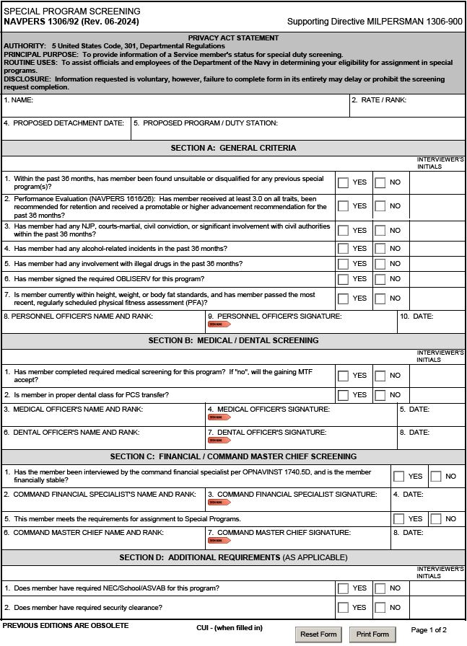
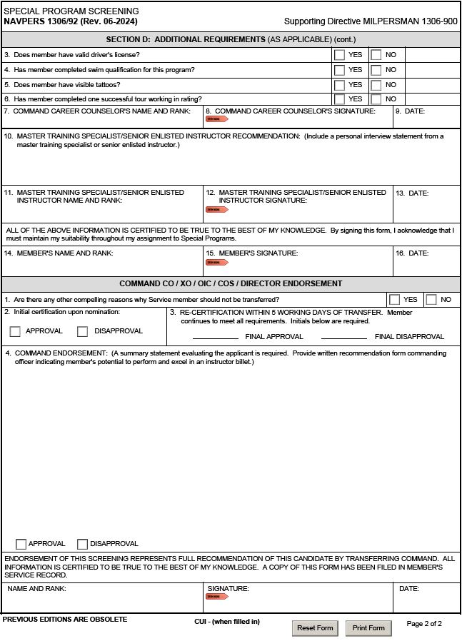
Special Program Screening Form NAVPERS 1306/92
SAMPLE
SAMPLE
Refer to the program's MILPERSMAN article for the required screening sections to complete
Notes:
FACILITATOR GUIDE:
Advise CDT members on how to properly complete the NAVPERS 1036/92. Recommend opening the form so members can see the full form.
Emphasize to read the MPM that applies to the program the Sailor is applying for because each program has different requirements and may not require all sections to be completed.
Section A should be completed by Admin Officer or Personnel Officer. Ensure to have supporting documentation for each section for verification. If OBLISERV is not complete; ensure to make a note on the form to annotate if it will be completed upon receipt of orders.
Completion of the remainder sections are self-explanatory

Slide 7
Shore Special Programs (PERS-4010)
Currently has over 14,000 Sailors detailed
Not geared toward a specific rating
The following programs will be highlighted however utilize MyNavy HR to find new and current opportunities:
Navy Recruiting
Recruit Division Commander (RDC)
Enlisted Detailing
Embassy Duty
USS Constitution
Instructor Duty
Notes:
FACILITATOR GUIDE:
1. The next few slides will provide examples of the types of Shore Special Programs available to Sailors.
2. CDT members must ensure to read the appropriate MPM article and any related NAVADMINs for special programs assignment to verify the current screening requirements.

Slide 8
Instructor Duty MILPERSMAN 1306-953
Instructors are detailed to commands responsible for formal training programs for military or civilian personnel.
Requirements:
E5 and above
Complete all sections of 1306/92
Be within PFA standards
Read Aloud Test (RAT)
Administer by local MTF, Independent Duty Corpsman (IDC), medical officer, or Master Training Specialist
High Risk Screening (as applicable)
Required for personnel detailed to training environments which exposes the crew, staff, and students to potential risks of death, permanent disability, or loss during training
Tour Length:
36 months
Notes:
FACILITATOR GUIDE:
Read aloud test can be retrieved from medical.
OPNAVINST 1500.75D has the requirements of High-Risk training screening.
Manual of the Medical Department (MANMED) P-117, chapter 15 article 15-95 (discusses read aloud test).
Additional screening requirements/instructions will also be sent via naval message from the detailer.
Instructor duty examples:
“A” and “C” schools
ATG
Senior Enlisted Academy
Professional Development Instructor (PDI)
NOTE: If you are in communities such as Medical, Submarines, Nuclear recommend providing instructor duty examples that are unique to those communities as well.

Slide 9
Enlisted Rating Detailer MILPERSMAN 1306-966
Foundation of the distribution management and placement of enlisted personnel.
Duties include:
Communicating with Sailors
Discuss assignment options and provide advice
Coordinate with distribution management and manning stakeholders
Responsible Office PERS-4010F
Forward package to respective rating detailer
Notes:
FACILITATOR GUIDE:
Additional information can be found at: Career-Management<Detailing<Enlisted<Shore Special<Enlisted-Detailing

Slide 10
Enlisted Rating Detailer (cont.)
Detailer candidates must meet the following minimum standards:
E5 and above
No EVAL traits below 3.0
Recommended for retention and received a promotable or higher for the past 36 months
No NJP, courts-martial conviction, or civil conviction within the past 36 or 60 months
No ARI's within the past 36 months
Must be within current BCA standards and passed the most recent PFA
No record of financial instability within the past 36 months
Eligible for a Secret security clearance
Be in accordance with normal sea/shore flow
Tour length:
36 months
Notes:
FACILITATOR GUIDE:
Note: There are support billets available for E4 and above.

Slide 11
Enlisted Rating Detailer (cont.)
Detailer Nomination Package Contents:
Commanding Officer's letter of recommendation
Completed NAVPERS 1306/92 Special Program Screening, except blocks D1, D4, and D10-D13
Provide close-up pictures of each visible tattoo and description of what they signify
EVALs for the past 36 months
An interview must be conducted by a branch head or higher
Notes:
FACILITATOR GUIDE:
None.

Slide 12
Recruiting Duty MILPERSMAN 1306-964
A rewarding program with incentives such as:
Special Duty Assignment Pay (SDAP) up to $450
Meritorious Advancement Program
Training (Sales Skills)
Opportunity to be stationed at a variety of locations
Responsible Office is PERS 4010C1
Contact rating detailer for the available districts and to have a Sailor nominated
Tour length:
36 months
Notes:
FACILITATOR GUIDE:
Highly recommend service members contact detailer PRIOR to in negotiation window for consideration.
Can also select during MNA window if available at the time.
3. Additional information at:
Career Management<Detailing<Enlisted<Shore Special<Recruiting

Slide 13
Recruiting Duty (CONT.)
Recruiting candidates must meet the following minimum standards:
Currently open to Paygrade E-4 to E-8 (E4 considered on a case-by-case basis)
E-4 may qualify for E-5 under the STAR program (check CSL under STAR incentives)
Valid States Driver’s License
Current security clearance
No performance marks lower than 3.0 in the past 36 months
No NJPs in the past 36 months
No PFA failures in the past 36 months (Must be in BCA standards at time of transfer)
Substantiated CMEO, DAPA, or FAP cases can be disqualifying
For visible tattoos in short sleeve PTU waiver provide photographs, close-up color picture of each tattoo and an explanation of the meaning
Notes:
FACILITATOR GUIDE:
These are only some of the screening requirements for RDC. See MPM article for specific requirements.

Slide 14
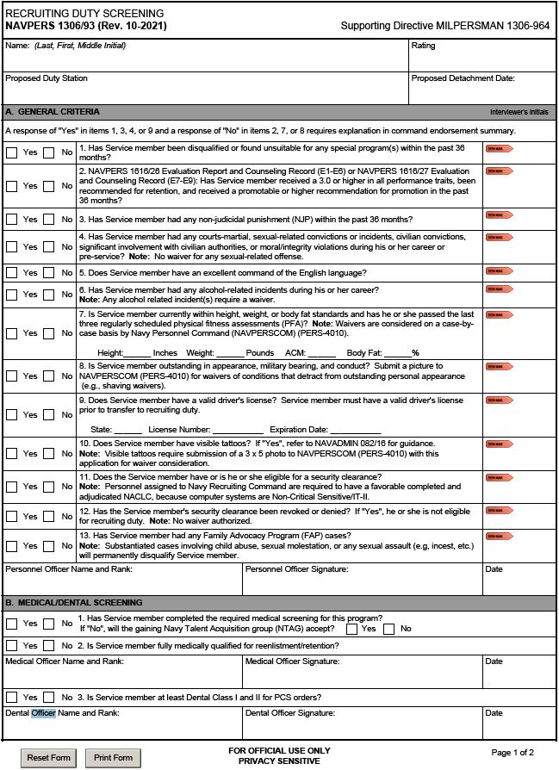
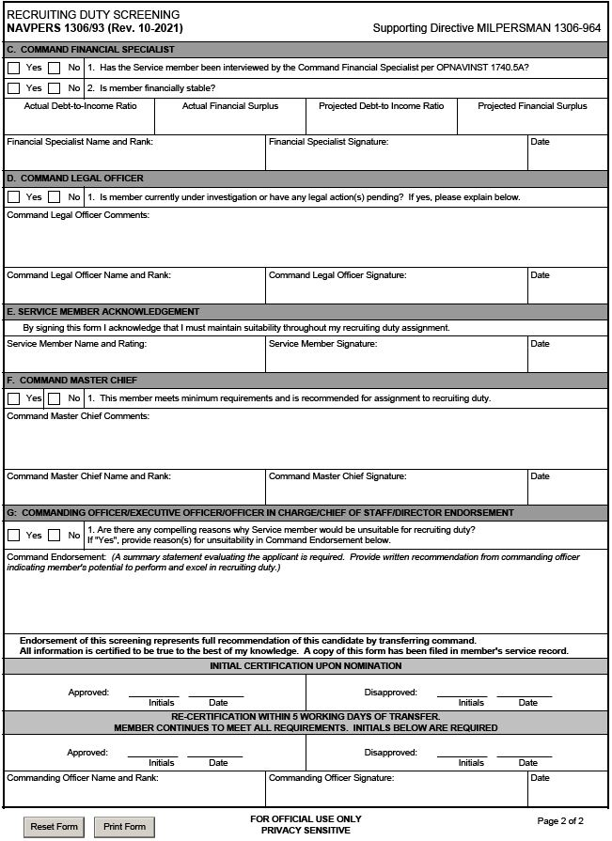
Recruiting Duty Screening NAVPERS 1306/93
SAMPLE
SAMPLE
Notes:
FACILITATOR GUIDE:
Review form.

Slide 15
Recruit Division Commander MILPERSMAN 1306-954
The #1 Sailorization and mentoring shore duty.
RDC offers:
Special Duty Assignment Pay (SDAP) up to $525
Additional clothing allowance and free dry cleaning
Opportunity to earn the Master Training Specialist (MTS) qualification
E7-E8 advancement is almost double the Navy average
Responsible Office PERS-4010D
Contact Shore Special Program Detailers to initiate the process
Opportunity to apply in MNA during orders negotiation window.
Notes:
FACILITATOR GUIDE:
Additional information can be found at: Career-Management<Detailing<Enlisted<Shore-Special<RDC

Slide 16
Recruit Division Commander (cont.)
RDC candidates must meet the following minimum standards:
Paygrade E-5 to E-9
No performance marks lower than 3.0 in the past 36 months
No legal issues (waiver required for any NJP, Civil, moral issues, waiver not authorized for any NJP or detachment for cause in the last 24 months)
Medical and Dental ready (no issues that prevent full participation)
Substantiated CMEO, DAPA, or FAP cases can be disqualifying
No PFA failures in the past 36 months, and in BCA standards
Must have a “good low” or higher on most recent PRT
Documented alcohol incident within previous 3 years or any two incidents during career is disqualifying
For visible tattoos in short sleeve PTU waiver provide full length photographs (front and both sides views), close-up color picture of each tattoo and an explanation of the meaning of each tattoo.
Notes:
FACILITATOR GUIDE:
These are only some of the screening requirements for RDC. See MPM article for specific requirements.

Slide 17
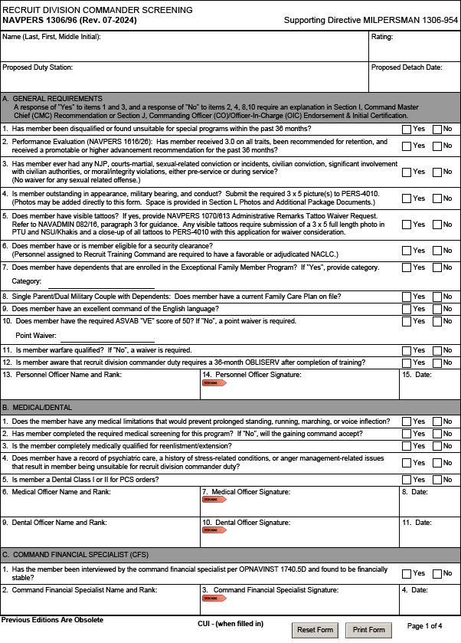
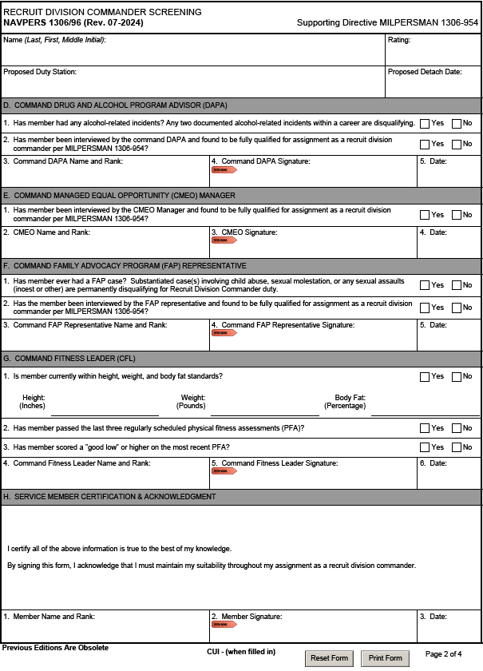
RDC Screening NAVPERS 1306/96
SAMPLE
SAMPLE
Notes:
FACILITATOR GUIDE:
Review form.

Slide 18
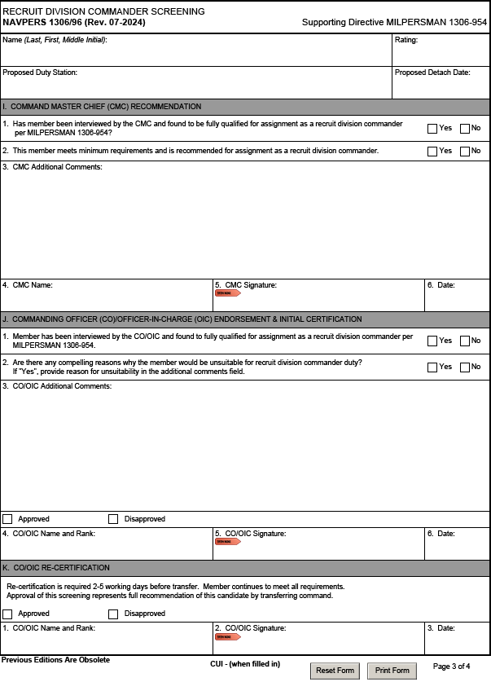
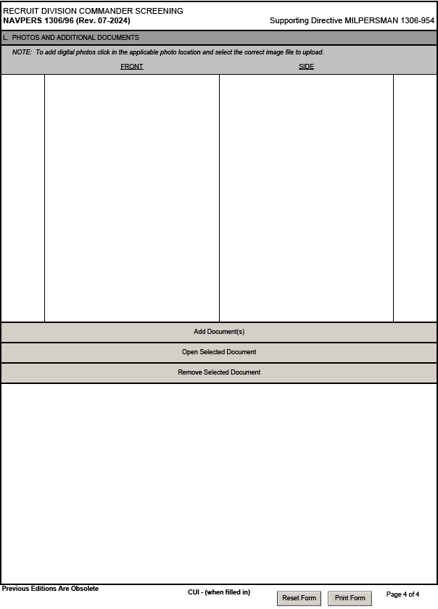
RDC Screening NAVPERS 1306/96
SAMPLE
SAMPLE
Notes:
FACILITATOR GUIDE:
Review form.

Slide 19
Embassy Duty MILPERSMAN 1306-914
Managed and detailed by PERS-4010G
Exotic & unique locations
Serve with the U.S. Defense Attaché Office (DAO) team; based in U.S. Embassies in more than 50 countries
Responsibilities of Staff Support Members:
Operations Coordinator (LDOs, CWOs, and E7/8/9)
Liaison within the DAO, performs managerial duties
Operations Assistant (E5-E8)
Performs administrative and operational support functions for the DAO
Notes:
FACILITATOR GUIDE:
Additional information can be found at: Career-Management<Detailing<Enlisted<Shore Special<Embassy Duty

Slide 20
Embassy Duty (cont.)
Eligibility requirements:
Must be an E5 and above
Hold a TS-SCI clearance
Complete a counterintelligence polygraph
Have no NJP in past 36 months
Have no record of drug or alcohol abuse
Have no financial problems
Be a US citizen
All dependents' must be US citizens
DLAB score minimum: 95
Member and family must complete screenings (no waivers)
Notes:
FACILITATOR GUIDE:
Waivers will not be granted for the requirements listed with the exception of:
DLAB can be waived on case by case basis
Dual-citizen waivers can be provided for dependents on a case by case basis

Slide 21
USS CONSTITUTION MILPERSMAN 1306-920
The oldest Navy ship still in commission
Sailors are tasked with promoting, protecting, and preserving the ship
Receives approximately half a million visitors annually
Non-petty officers screened directly from RTC by CMDCM or CMDCS of USS Constitution will complete a 24-month tour
Tour Length:
E-1 through E-3 will serve 24 months
E-4 through E-9 will serve 36 months
"OLD IRONSIDE"
Notes:
FACILITATOR GUIDE:
See MPM for complete list of requirements.

Slide 22
USS CONSTITUTION (cont.)
Requirements:
Sailors who wish to volunteer for duty aboard USS Constitution must demonstrate maturity and tact when interacting with the public and present themselves as model representatives of the U.S. Navy, maintaining impeccable appearance and military bearing.
ASVAB: WK=50, VE=50
No NJP in past 36 months
No DUI in past 5 years
No financial instability in last 36 months
No eval traits below 3.0 in past 36 months
Must pass most recent PFA and have smart military appearance
Homeported in Boston, MA
Notes:
FACILITATOR GUIDE:
Requirements cont…:
Be fit for full duty
No tattoos visible in short-sleeves or skirts (waiverable)
Not afraid of heights
Non-POs must be unmarried and without dependents

Slide 23
Sea Special Programs (PERS-409)
Sea Special programs is responsible for the Navy’s:
New Construction units
Landing Craft, Air Cushion (LCAC)
The following programs will be highlighted:
New Construction
Landing Craft, Air Cushion (LCAC)
Notes:
FACILITATOR GUIDE:
None.

Slide 24
New Construction MILPERSMAN 1306-802
Sailors can experience becoming a “plank owner.”
Pre-commissioning (PRECOM) of a new construction is a fast paced, demanding period that requires the highest level of performance from everyone assigned to include:
Intensive efforts to establish the administrative and training readiness of the unit for future operations
This stage is not equipped to handle excessive personnel-related administrative burdens
Responsible office is PERS-409/ PRECOM Detailer
Notes:
FACILITATOR GUIDE:
Additional information is found at: MyNavyHR<Career Management<Detailing<Enlisted<Sea Special Programs

Slide 25
New Construction (cont.)
Candidates must be screened using NAVPERS 1300/18, New Construction Screening and meet the following minimum standards:
No civil convictions, courts-martial, non-judicial punishments, or significant involvement with civil authorities in the past 12 months
Not currently on legal hold or pending ADSEP
Currently within BCA standards, and passed most recent PFA
No evidence of drug abuse or alcohol-related incidents in the past 12 months
No performance marks lower than 3.0 and recommended for retention in the past 24 months
No history of serious physical or mental health problems
Be able to complete OBLISERV:
Minimum 24 months required after ship’s in-service or DOD area tour for those assigned overseas
Notes:
FACILITATOR GUIDE:
Standards cont....
No evidence of drug abuse in the past 12 months.
No alcohol-related incidents in the past 12 months.
Must be a U.S. citizen for nuclear ships (most rates).
Have performance marks of at least 3.0 in all traits, be recommended for retention, and receive a promotable or higher recommendation for the previous 24 months.
Additional Notes:
Personnel without prior sea duty, PRDs will be assigned as follow from the date of the ship’s in-service:
1st enlistment: assigned IAW PST for 1st sea tour
2nd or more: assigned IAW PST for the assigned rating (see sea/shore flow)
HYT waivers must be approved prior to issuance of orders to allow the Sailor to meet OBLISERV requirements:
Request via 1306/7 to BUPERS -328

Slide 26
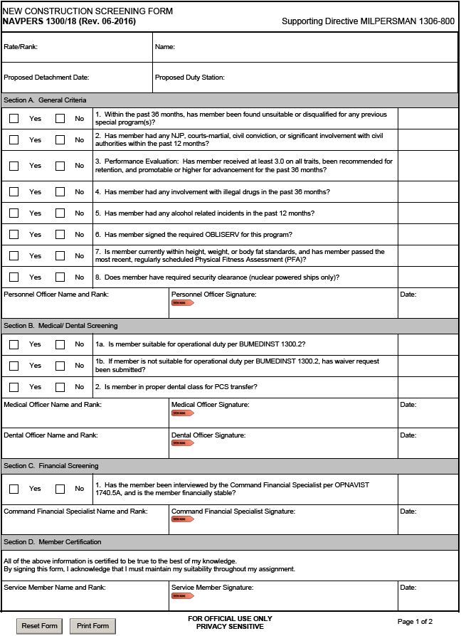
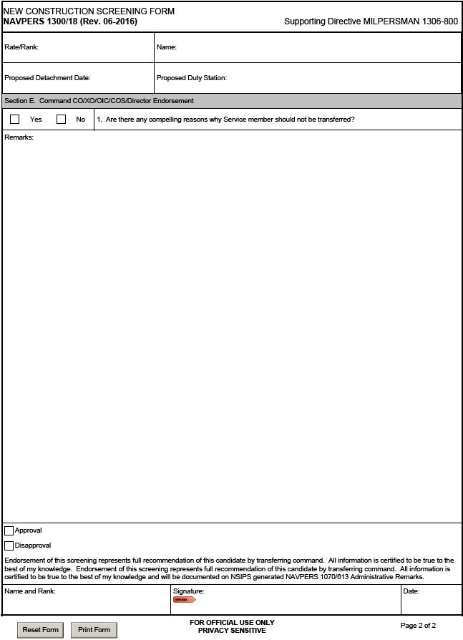
New Construction Screening Form NAVPERS 1300/18
SAMPLE
SAMPLE
All sections must be completed
Notes:
FACILITATOR GUIDE:
Advise CDT members on how to properly complete the NAVPERS 1036/92
Emphasize to read the MPM that applies to the program the Sailor is applying for because each program has different requirements and may not require all sections to be completed.
Section A should be completed by Admin Officer or Personnel Officer *this can also be either the YN or PS Chief*. Some commands may have a 1st class serving in this role. As long as they are designated as such they can also complete this section. Ensure to have supporting documentation for each section for verification. If OBLISERV is not complete; ensure to make a note on the form to annotate if it will be completed upon receipt of orders.

Slide 27
Landing Craft, Air Cushion (LCAC) MILPERSMAN 1306-949
$23-million-dollar Landing Craft manned entirely by enlisted crews with a CPO or above in charge
Primarily used for transporting, ship-to-shore/across the beach personnel, weapons, equipment, and cargo for assault elements of the Marine Air-Ground Task Force
Responsible Office is PERS-409/ LCAC Detailer
Notes:
FACILITATOR GUIDE:
Additional details can be found at: Career-Management<Detailing<Enlisted<Sea Special<LCAC

Slide 28
Landing Craft, Air Cushion (CONT.)
LCAC candidates must meet the following minimum standards:
2nd class swim qualified
ASVAB score GS+AR+MK+EI = 204 or greater (Craftmaster, Craft engineer, and craft navigator, waiver for 5 points or less will be granted)
Be physically quailed IAW NAVMED P-117
Complete the LCAC performance-based measurement test (LCAC BAM)
Three lifetime attempts are allowed (min 30 days in-between each attempt)
Current valid score will be used, even if previous scores were higher
Complete the LCAC Service Life Extension Program Operations Prerequisite Course
Valid secret security clearance per SECNAVINST 5510.30C
Notes:
FACILITATOR GUIDE:
See MPM article for additional screening requirements.

Slide 29
Landing Craft, Air Cushion (CONT.)
There are 5 LCAC crew members: Open to all ratings in the following paygrades:
LCAC Craftmaster (NEC-800A): E7-E9
LCAC Engineer (NEC-729B): E5-E7
LCAC Navigator (NEC-701B): E5-E7
LCAC Loadmaster (NEC-700B): E3-E6
Deck Engineer (NEC-728B): E3-E6
Tour Lengths:
60 months: Initial tour for NECs 800A, 729B, and 701B
PST for assigned rating for NECs 728B and 700B
Notes:
FACILITATOR GUIDE:
None.

Slide 30

Common Special Duty Assignments
MILPERSMAN Code | Program Description
1306-912 | Seabee Underwater Construction Technician (UCT) Program
1306-913 | Flag Writer (NEC 2514)
1306-916 | Naval Drug and Alcohol Counselor and Intern
1306-917 | Navy Equal Opportunity Advisor (EOA)
1306-919 | Navy Flight Demonstration Squadron (NAVFLIGHTDEMRON) (Blue Angels)
1306-920 | USS Constitution
1306-927 | Navy Harbor Pilot Program
1306-925 | Senior Enlisted Academies (SEAs)
1306-928 | Navy Music Program (MU)
1306-935 | Command Master Chief (CMC) Program
1306-939 | White House Communication Agency (WHCA)
1306-942 | USS Arizona Memorial
1306-945 | Flag Officer (Staff) Duty
1306-953 | Instructor Duty
1306-954 | Recruit Division Commander (RDC) Duty
1306-964 | Recruiting Duty
1306-965 | Career Recruiter Force (CRF)
1306-966 | Enlisted Rating Detailer
1306-968 | Camp David (Naval Support Facility, Thurmont, MD)
1306-979 | Recruitment/Assignment to Commander, Naval Special Warfare Development Group (DEVGRU)
Notes:
FACILITATOR GUIDE:
At this point, remind class to ensure they are looking at MILPERSMAN

Slide 31
Knowledge Check
Why is it important to send motivated Sailors to PRECOM duty?
How many Shore Special Programs are there?
Which NAVPERS screening form is used for most special programs?
Which NAVPERS screening form is used for Recruiting?
Notes:
ANSWERS:
1. PRECOM requires intensive efforts to establish the administrative and training readiness of the unit for future operations and is not equipped to handle excessive personnel-related administrative burdens
2. 26 various programs
3. NAVPERS 1306/92
4. NAVPERS 1306/93

Slide 32
Summary and Review
In this lesson we discussed:
The two categories of Enlisted Special Programs
The types of sea and shore special programs available
Eligibility requirements
The screening forms required for completion

Slide 33
Questions?

